Slide 1
Automated psychological therapy using immersive virtual reality for treatment of fear of heights: a single-blind, parallel-group, randomised controlled trial
Journal：Lancet Psychiatry
Impact factor：18.329

Slide 2
Introduction
1. In the UK, one adult in six meets criteria for a common mental health disorder but most of these individuals do not receive treatment.
2. For anxiety disorders, evidence-based psychological treatments（循证心理治疗） are both the best treatment option and the preference of patients.
3. Therapists need to be trained and then adhere competently to evidence-based treatment protocols, but most therapists typically have little time for sessions outside the clinic.
4. Solution: Using Immersive virtual reality
(1) Treatments can be automated and provided in VR, so a therapist does not need to be present.

Slide 3
Introduction
4. Solution: Using Immersive virtual reality（续）
(2) By putting on a headset, patients can be taken immediately into various situations, that they find cause psychological distress, which is too frequently missing in clinics.
(3) In VR, patients are willing to go into situations that trouble them and try alternative ways of responding, because they know it is a simulation.
5. Aim:
(1) Automate the provision of a psychological intervention for fear of heights by programming a virtual coach to act as the therapist in VR.
(2) Our therapeutic approach is cognitive, focusing on the evaluation of threat predictions while dropping defensive behaviours, to develop memories of safety that counteract fear associations.

Slide 4
Methods
1. Participants:
(1) 49 allocated to VR intervention.
(2) 51 allocated to control group (no treatment).
(3) A participant had to be older than 18 years and have a fear of heights corresponding to a Heights Interpretation Questionnaire (HIQ) score of more than 29.

Slide 5
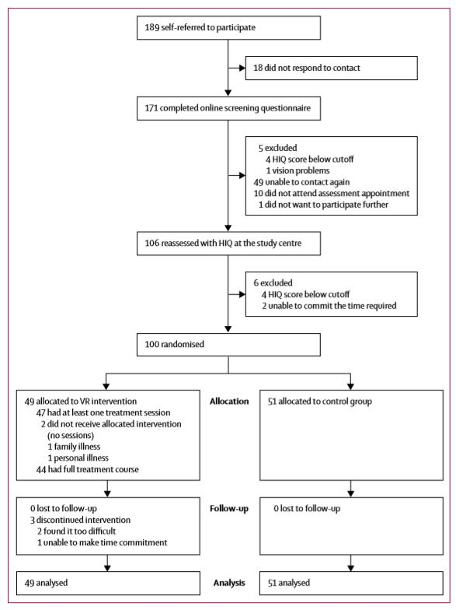

Slide 6
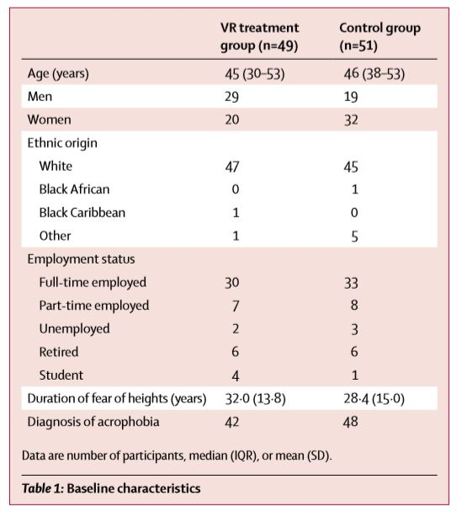

Slide 7
Methods
2. The VR intervention:
(1) A software application called Now I Can Do Heights(Unity3D), a gaming personal computer, HTC Vive, headphones with a microphone.
(2) Six 30-min VR sessions over a period of 2 weeks:
(a) The virtual coach in the software was animated using motion capture from an actor and voiced by the same person.
(b) At the beginning of the first session, the coach asked the participant a series of questions about their key fear about heights.
(c) Throughout the programme, participants were encouraged by the virtual coach to find out how safe they were and to put their expectations to the test.
(d) The treatment was not designed as exposure therapy, but as repeated behavioural experiment tests (ie, to learn that they were safer than they had thought).

Slide 8
Methods
2. The VR intervention:
(2) Six 30-min VR sessions over a period of 2 weeks（续）
(e) The virtual coach took the participant to the atrium of a large ten-storey office complex with many height cues, the participant then chose on which of the floors to begin the activities.
(f) Tasks were randomised across all the remaining floors for every participant, but were weighted towards the easiest tasks whereas harder tasks came later (eg, going out on a platform from the floor into the atrium space, rescuing a cat from a tree, playing a xylophone near the edge of the floor, throwing balls over the edge of the floor).
(g) The participant could decide to repeat tasks or move up to the next floor.
(h) At the end of the session, the intervention was saved and the coach would ask for belief ratings for the height threat and encourage the participant to try real heights between sessions.

Slide 9
Outcomes
1. Heights Interpretation Questionnaire (HIQ)
2. Acrophobia（恐高症） Questionnaire (AQ)
(1) AQ total score
(2) AQ anxiety score
(3) AQ avoidance score
3. Improving Access to Psychological Therapies (IAPT) phobia scale
4. Sickness Questionnaire (SSQ) to assess levels of discomfort provoked by a VR session.

Slide 10
Results
1. Participants allocated to the VR treatment group had very large reductions in scores on the three fear-of-heights assessments from baseline to 4 weeks, whereas scores for the control group remained stable.
2. Levels of discomfort (as assessed by the SSQ) were very low before entering VR for the first time and discomfort increased only slightly after being in VR.
3. In both treatment groups, men seemed to do slightly better than women.

Slide 11
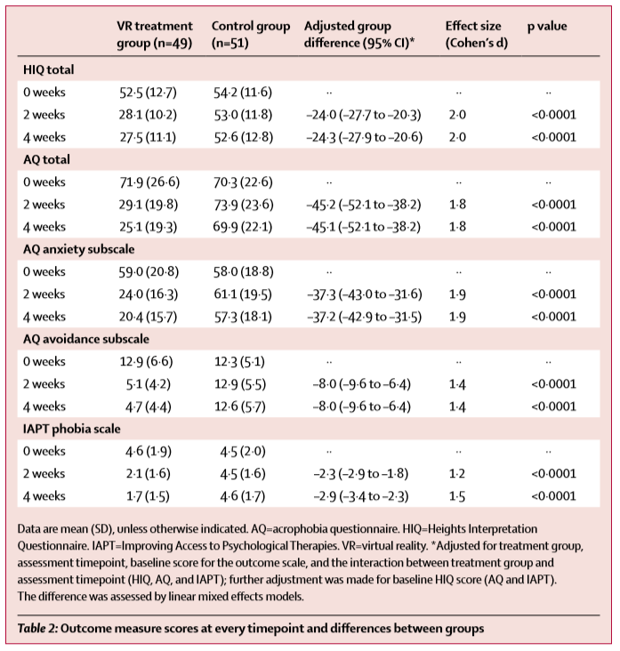
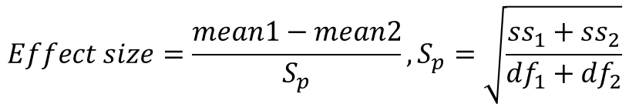
Results
$$Effect size=\frac{mean1−mean2}{S_{p}},S_{p}=\sqrt{\frac{{ss}_{1}+{ss}_{2}}{{df}_{1}+{df}_{2}}}$$

Slide 12
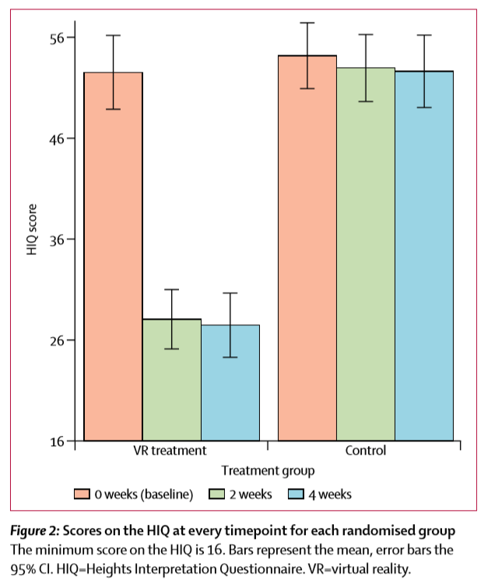
Results

Slide 13
Conclusion
1. An automated psychological intervention delivered by immersive VR is highly effective for reduction of fear of heights.
2. Levels of discomfort (as assessed by the SSQ) were very low before entering VR for the first time and discomfort increased only slightly after being in VR.
3. The treatment effects produced were at least as good as—and most likely better—than the best psychological intervention delivered face-to-face with a therapist.

Slide 14
Limitations
1. We do not know how representative our participants are of the wider population of people with acrophobia.
2. We relied on established acrophobia questionnaires and did not test behaviour at real heights.
3. We did not test long-term outcomes of the VR treatment.
4. How effective in total was the VR treatment against the absence of other treatment.
5. We can only conclude that the automated VR treatment produces large reductions in fear of heights, but we cannot pinpoint which elements caused the reduction.

